Slide 1
Pattern Recognition

Slide 2
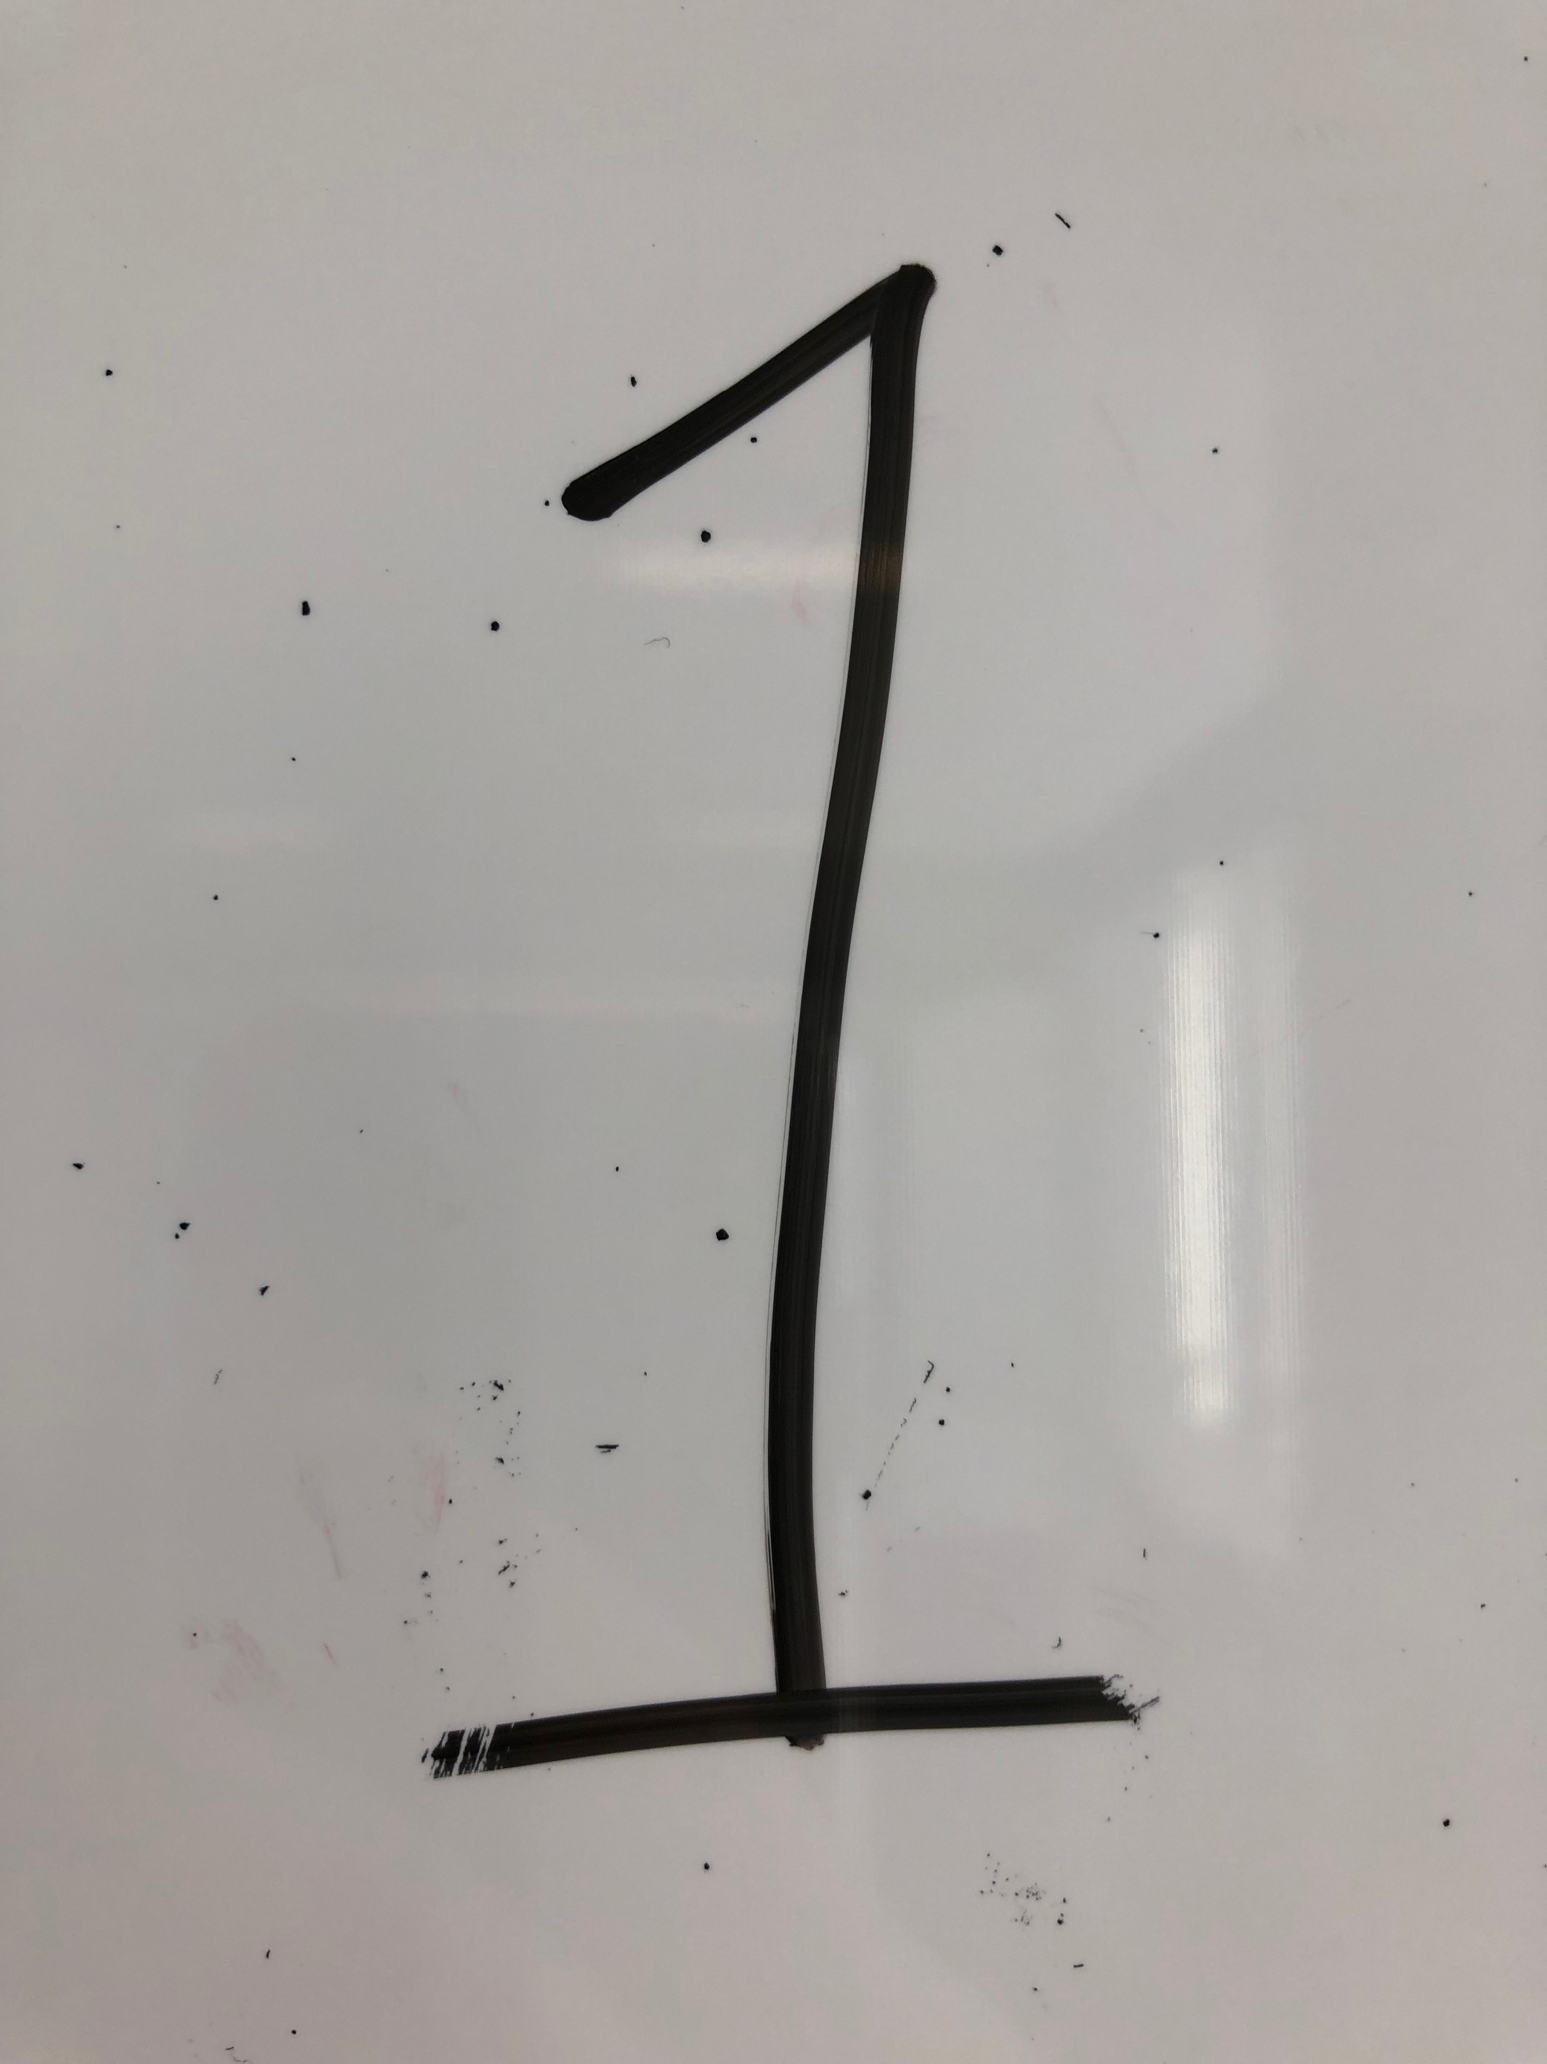
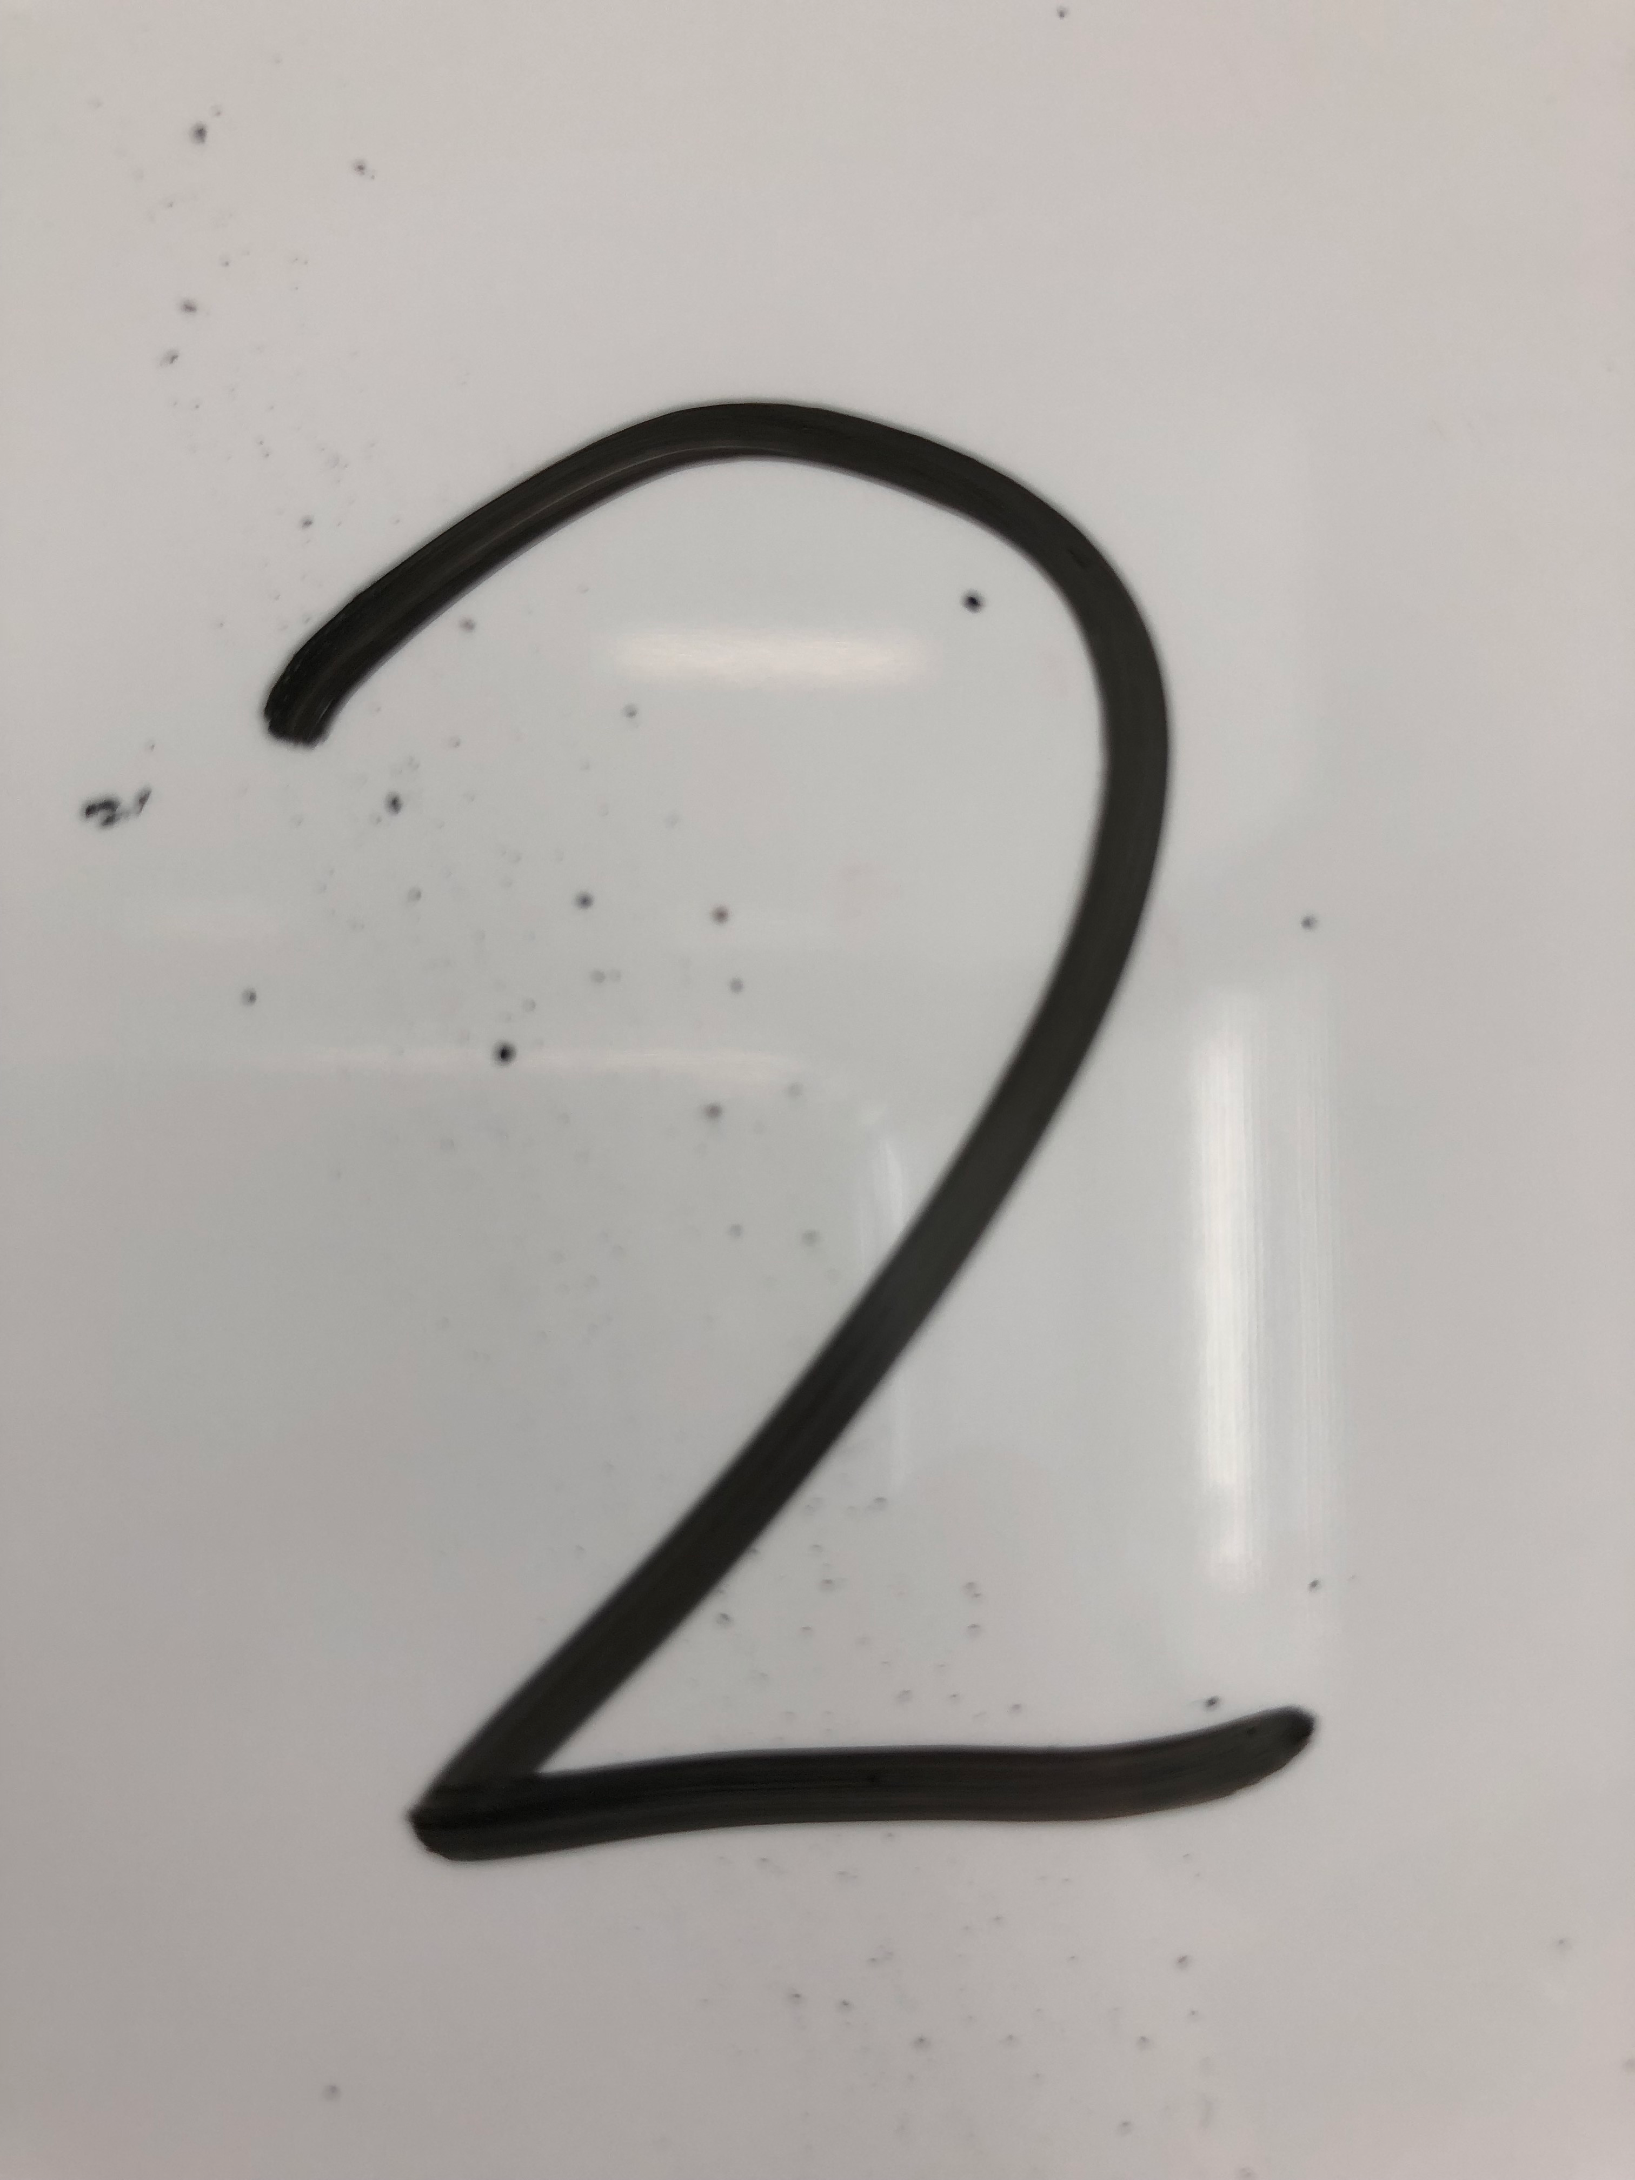
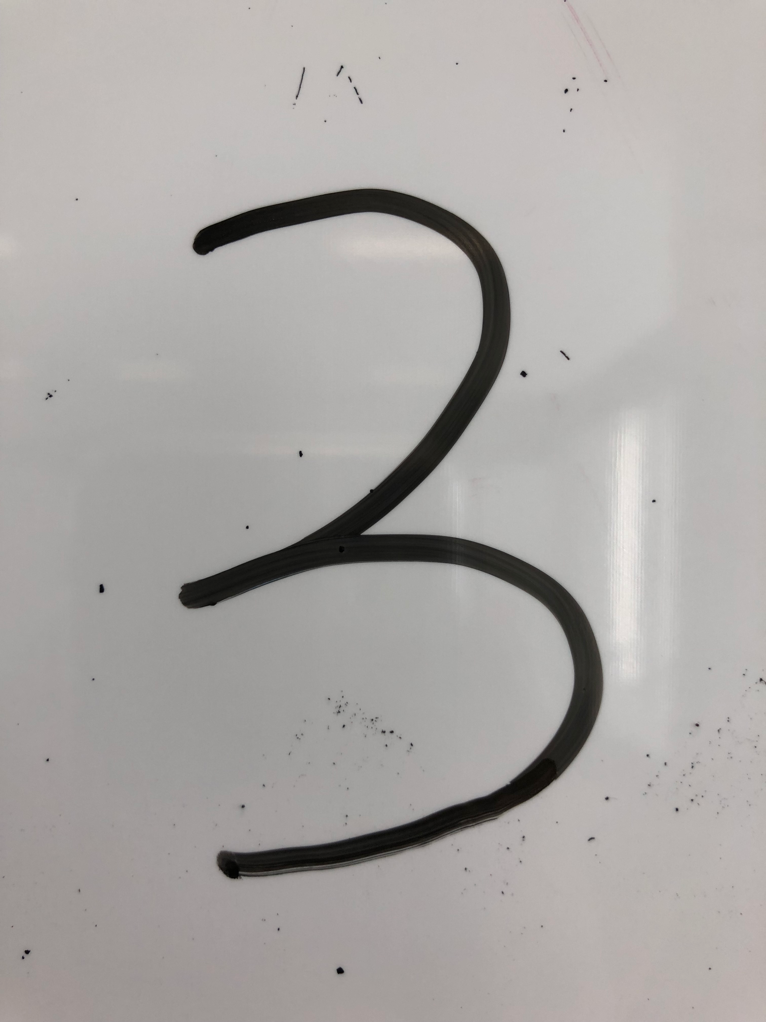
Data & Results
X
X

Slide 3
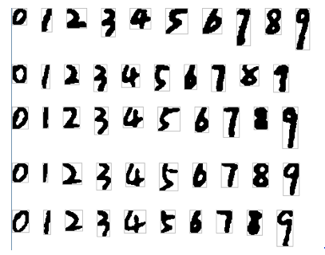
Optimization
Using age detection to get train samples from raw data

Slide 4
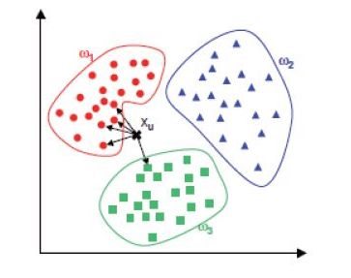
More Optimization
KNN is proposed in many different clustering problems

Slide 5
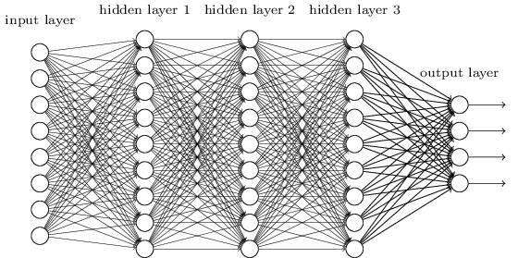
Better Method
Layers structure of a simple neural network

